Slide 1
Data analysis with Jupyter Notebook for Open Science
Hans Fangohr
European X-ray Free Electron Laser
Photon and Neutron Open Science Cloud
Amsterdam, 7 May 2019
Hans.Fangohr@xfel.eu
https://fangohr.github.io
@ProfCompMod

Slide 2
Photon and Neutron Open Science Cloud
– team effort
Sandor Brockhauser (EuXFEL)
Aidan Campbell (ESRF)
Hans Fangohr (EuXFEL)
Andy Götz (ESRF)
Jamie Hall (ILL)
Jerome Kieffer (ESRF)
Thomas Kluyver (EuXFEL)
Eric Pellegrini (ILL)
Jean-François Perrin (ILL)
Carlos Reis (CERIC-ERIC)
Thomas Rod (ESS)
Robert Rosca (EuXFEL)
Jesper Selknaes (ESS)
Krzysztof Wrona (EuXFEL)
ESRF: European Synchrotron Radiation Facility
ILL: Institut Laue-Langevin
EuXFEL: European X-ray Free Electron Laser Facility
ESS: The European Spallation Source
CERIC-ERIC: The Central European Research Infrastructure Consortium
ELI: Extreme Light Infrastructure

Slide 3
Outline
Open Science, Data Analysis, Jupyter
PaNOSC requirements and vision
Challenges
Summary

Slide 4
Data Analysis for Open Science
(FAIR) data is central for Open Science
Data provides potential for new understanding
Data analysis extracts the meaning from the data
Publications based on data
Data sources should be known
Central findings (figures, tables, numbers) should be reproducible

Slide 5
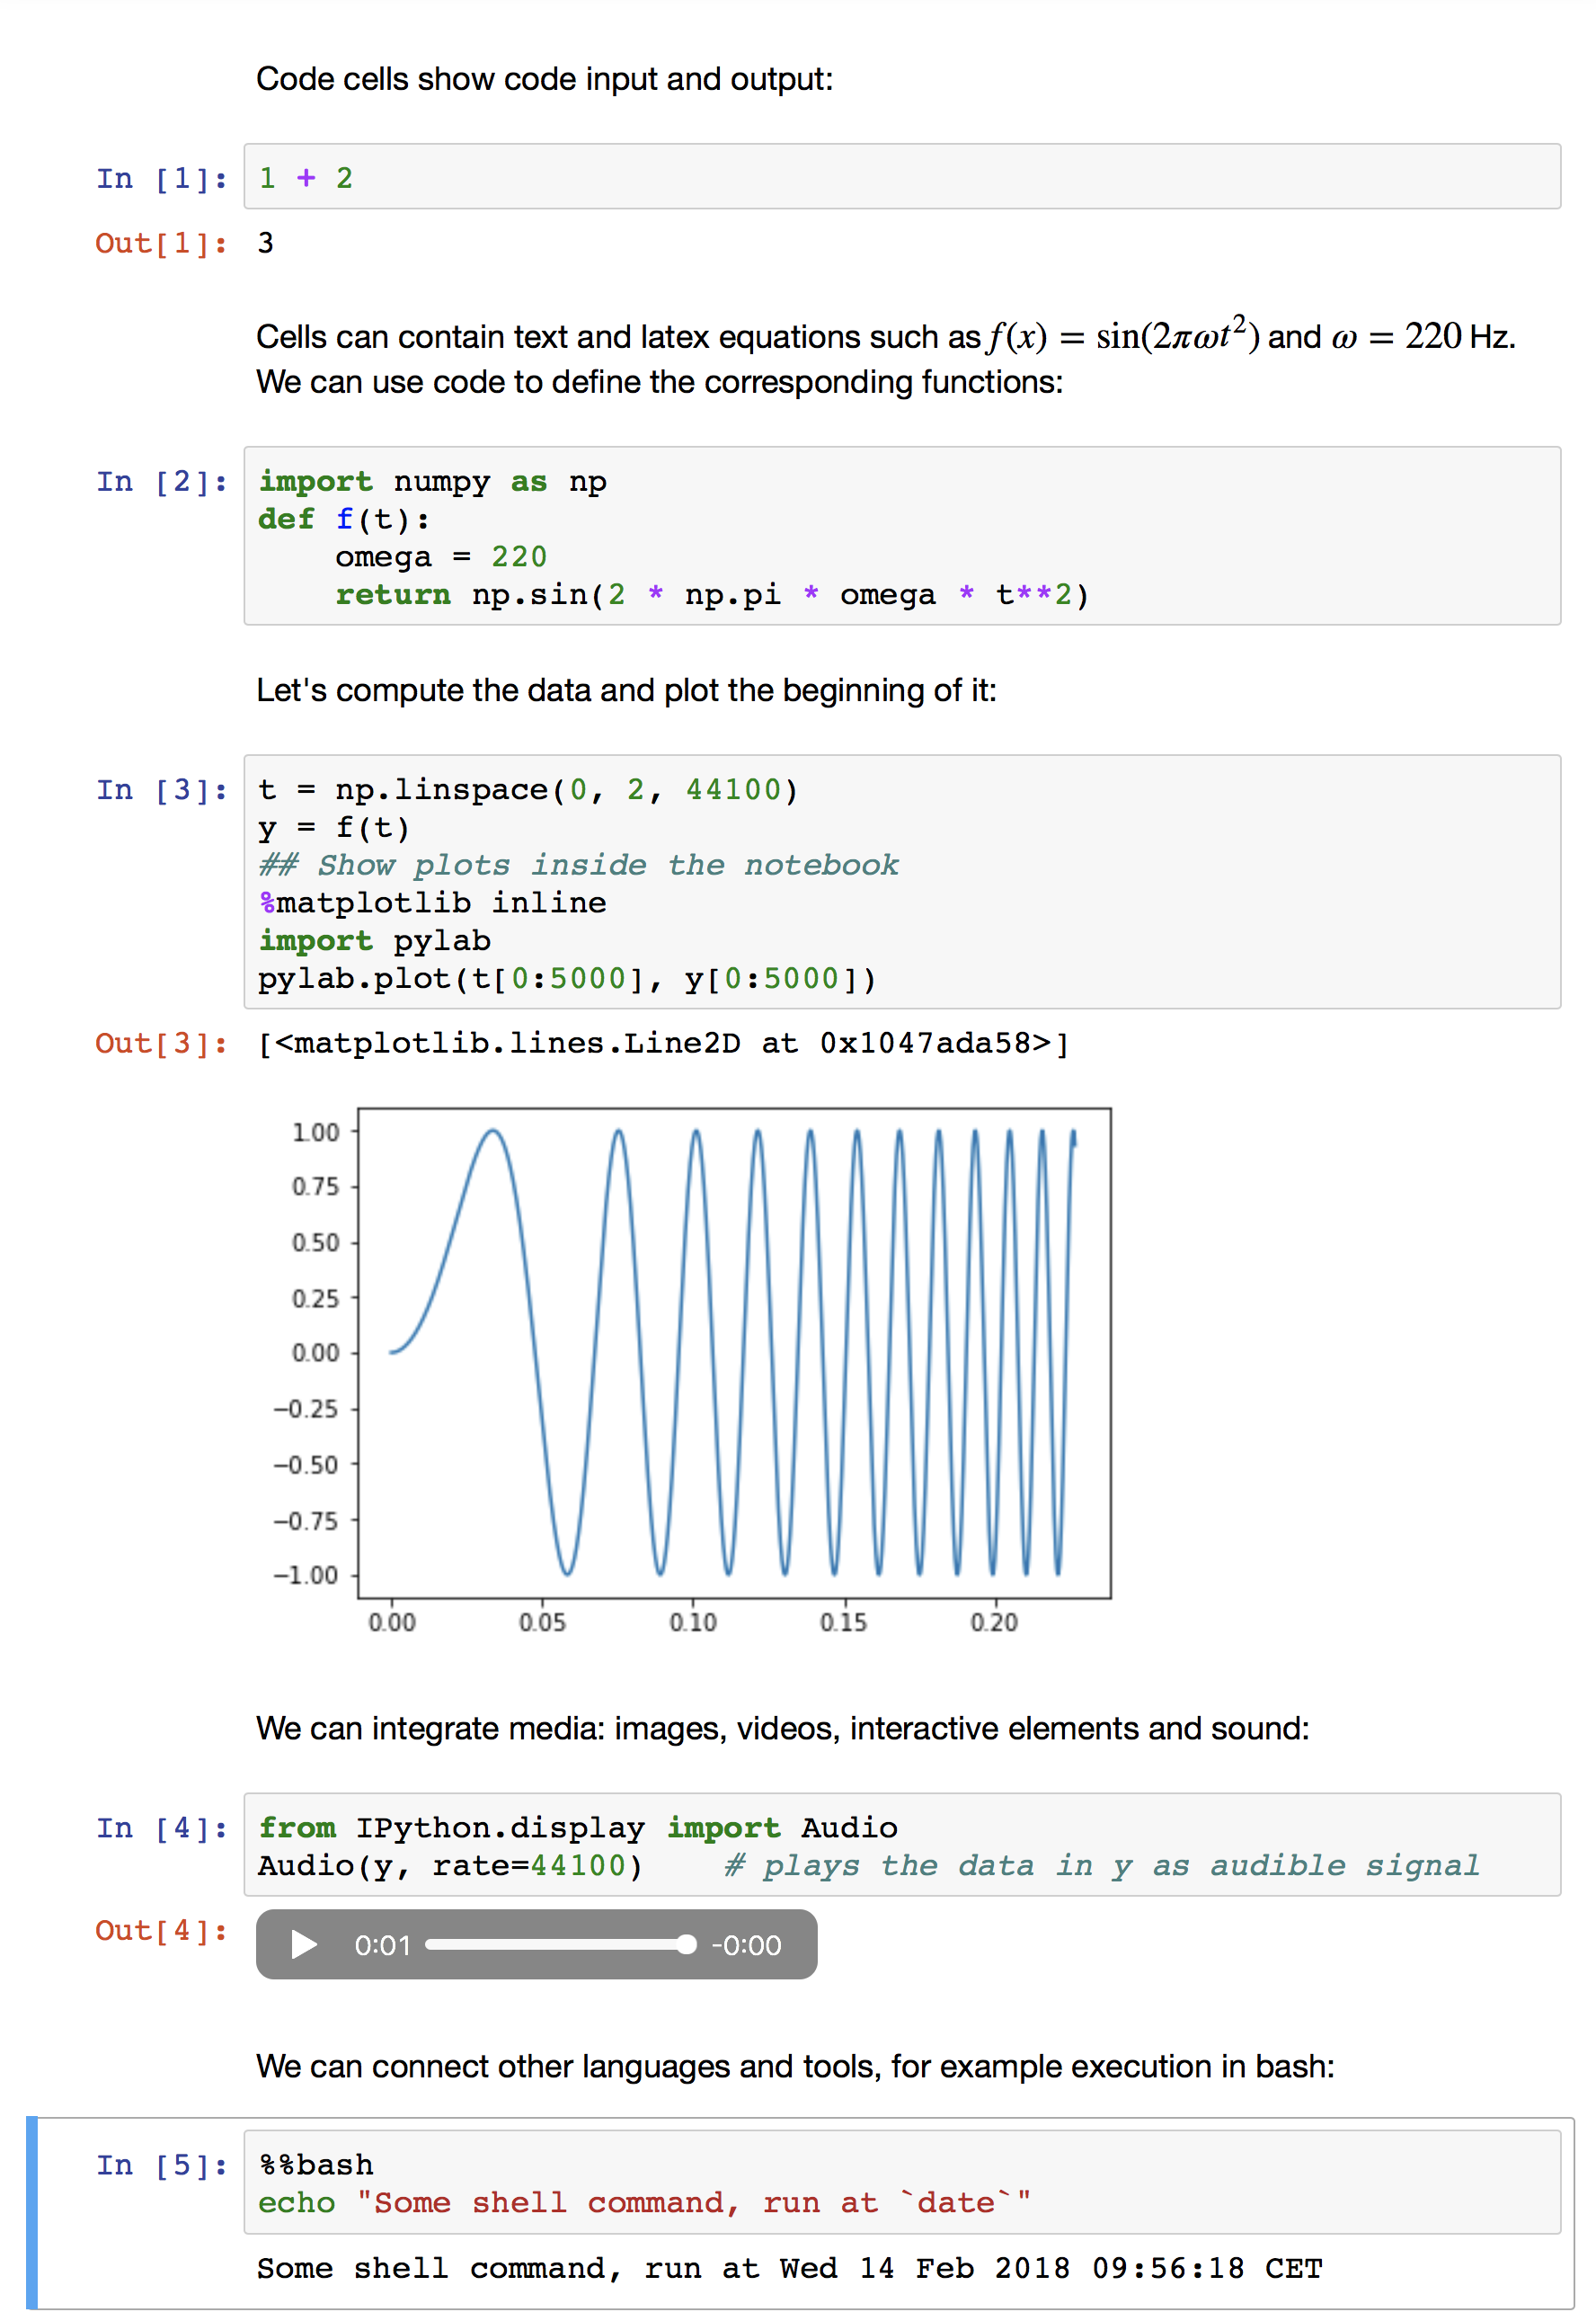
Jupyter Notebook
Cells contain
(formatted) text
Code
Output from code execution
(multimedia)
Can execute cells interactively
Can save, close, load and re-execute
Can export to other file formats
Remote execution via https possible

Slide 6
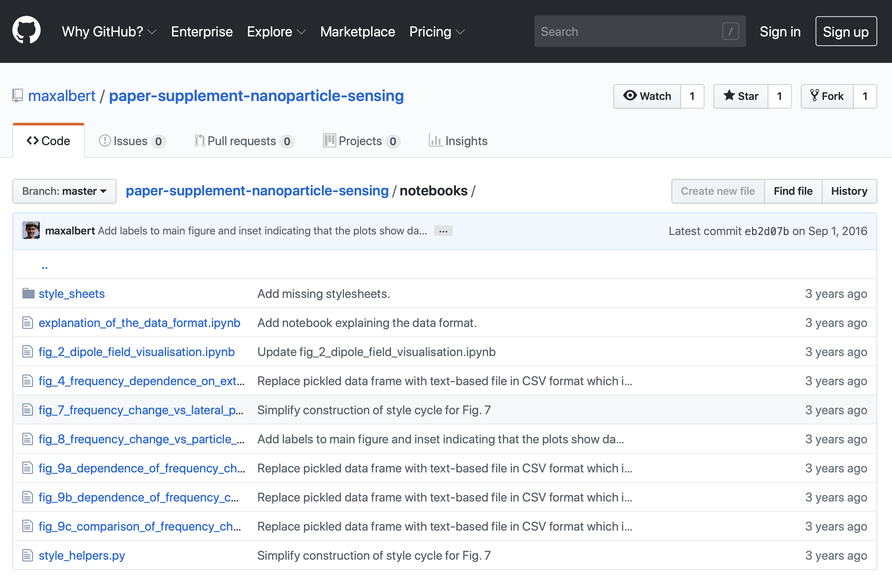
Jupyter Notebook for Open Science
Combination of code, output and annotation in one document
If used appropriately, makes publications reproducible
For example: one notebook per figure in publication (examples: [1], [2])
Notebooks from reproducible publications make the work re-usable
Currently, lots of time is used by researchers to repeat the work of others, before they can advance science.
[1] Appl. Phys. Lett. 109, 122401 (2016), https://doi.org/10.1063/1.4962726, https://github.com/fangohr/paper-supplement-2016-dmi-nanocylinder-hysteresis [2] Nanotechnology 27, 455502 (2016), https://doi.org/10.1088/0957-4484/27/45/455502 https://github.com/maxalbert/paper-supplement-nanoparticle-sensing

Slide 7
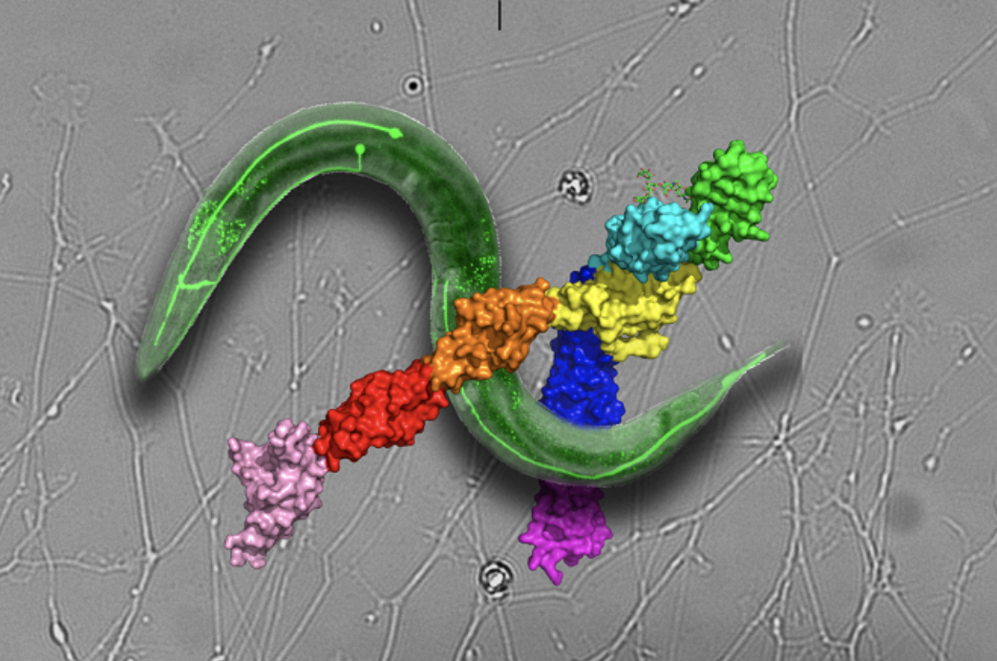
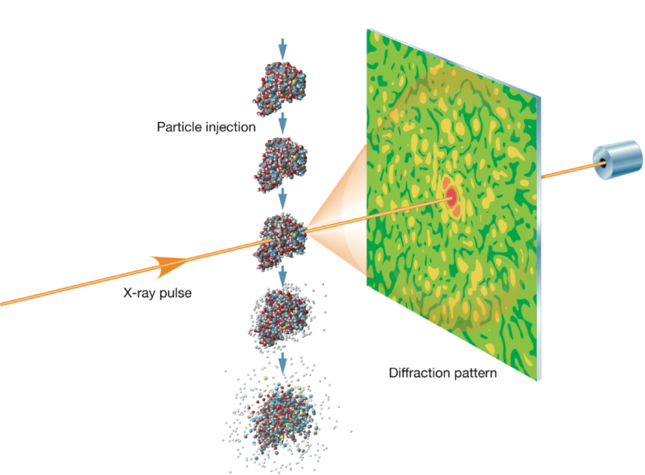
Photon and Neutron Open Science Cloud (PaNOSC)
Research facilities using Photons and Neutrons for imaging
Underpins a wide range of fundamental and applied research, from basic physics to drug design
European XFEL: use short-wavelength photons to image small things
Infrastructure
3.4km tunnel
Accelerate electrons, then create photons from electrons
Data volume
Typical detector: 1 million pixels, each using 2 bytes
up to 27,000 X-ray pulses per second
→ 2 byte * 1,000,000 * 27,000 / s = 54 GB/s
→ 194 TB/h (theoretical peak)
https://www.esrf.eu/home/news/general/content-news/general/clear-view-of-robo-neuronal-receptor-opens-door-for-new-cancer-drugs.html

Slide 8
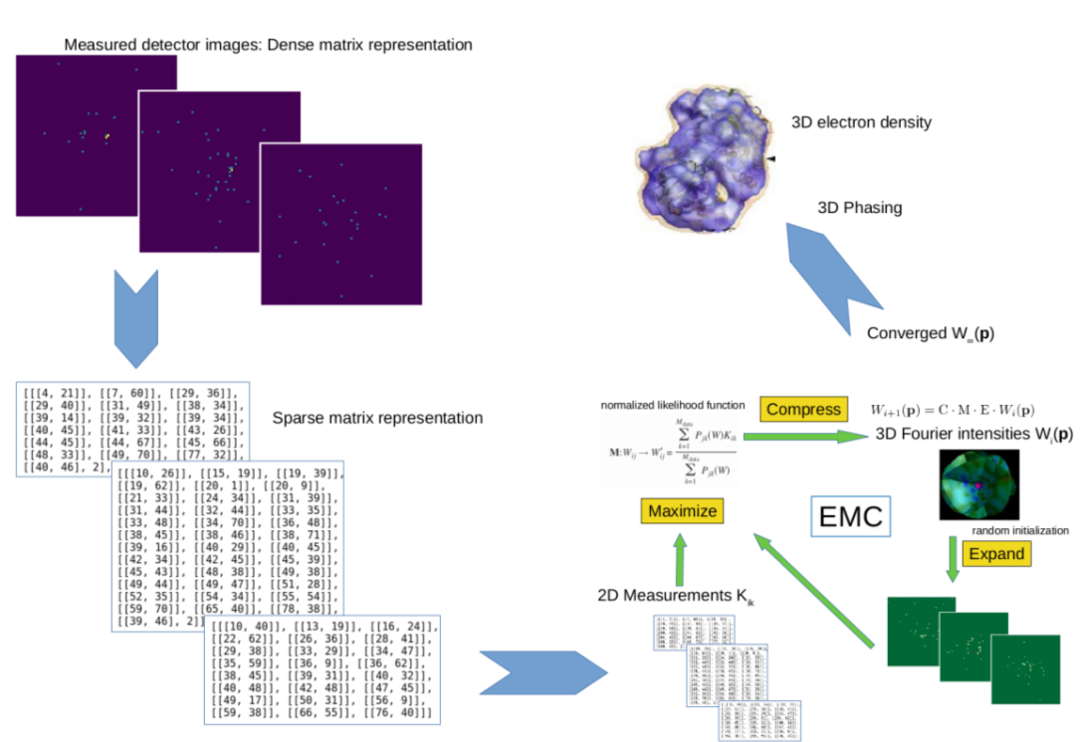
Current state of data analysis: example European XFEL
Data source:
2d image detectors (up to 27,000 images /s)
Scalar values (typically 10 values per second)
others
Data analysis
Calibration, data filtering, reduction, azimuthal integration, real space reconstruction, …
Many steps involving different programs
connect via ssh –X to HPC cluster
some programs use GUIs (X display at EuXFEL)
some programs use command line
Increasingly Jupyter Notebooks

Slide 9
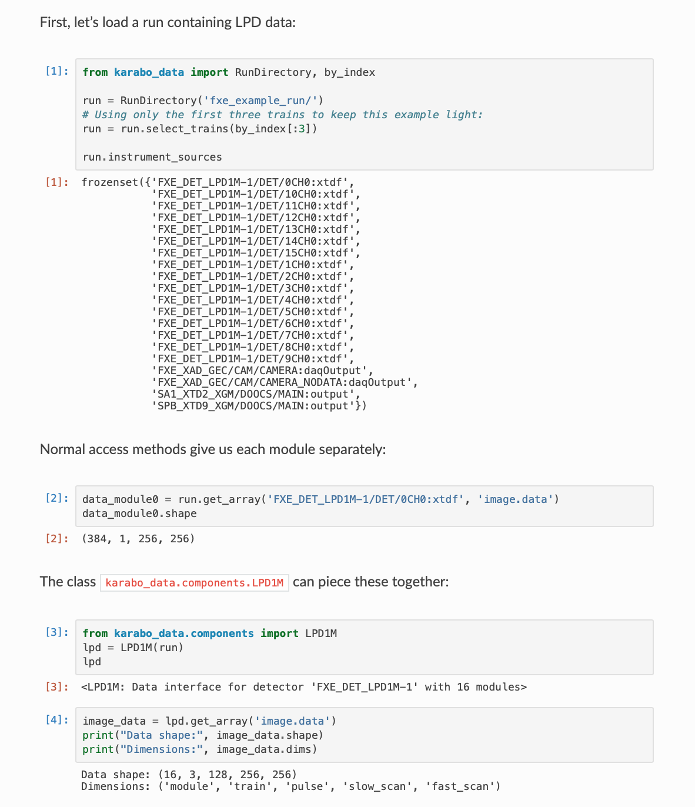
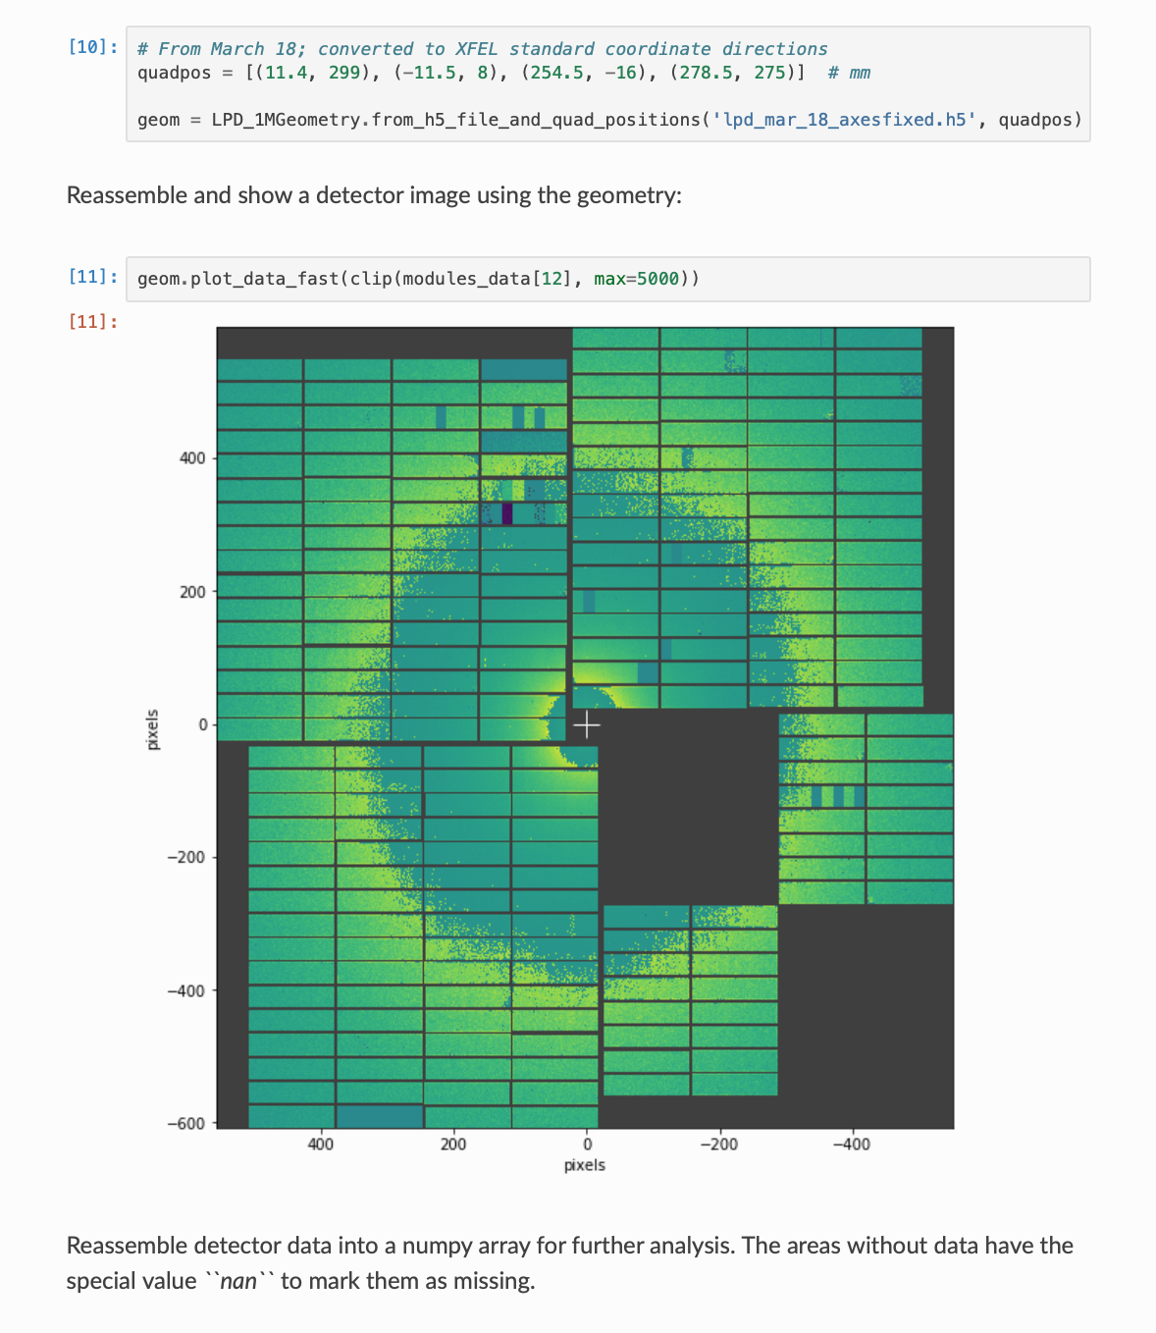
https://karabo-data.readthedocs.io/en/latest/index.html

Slide 10
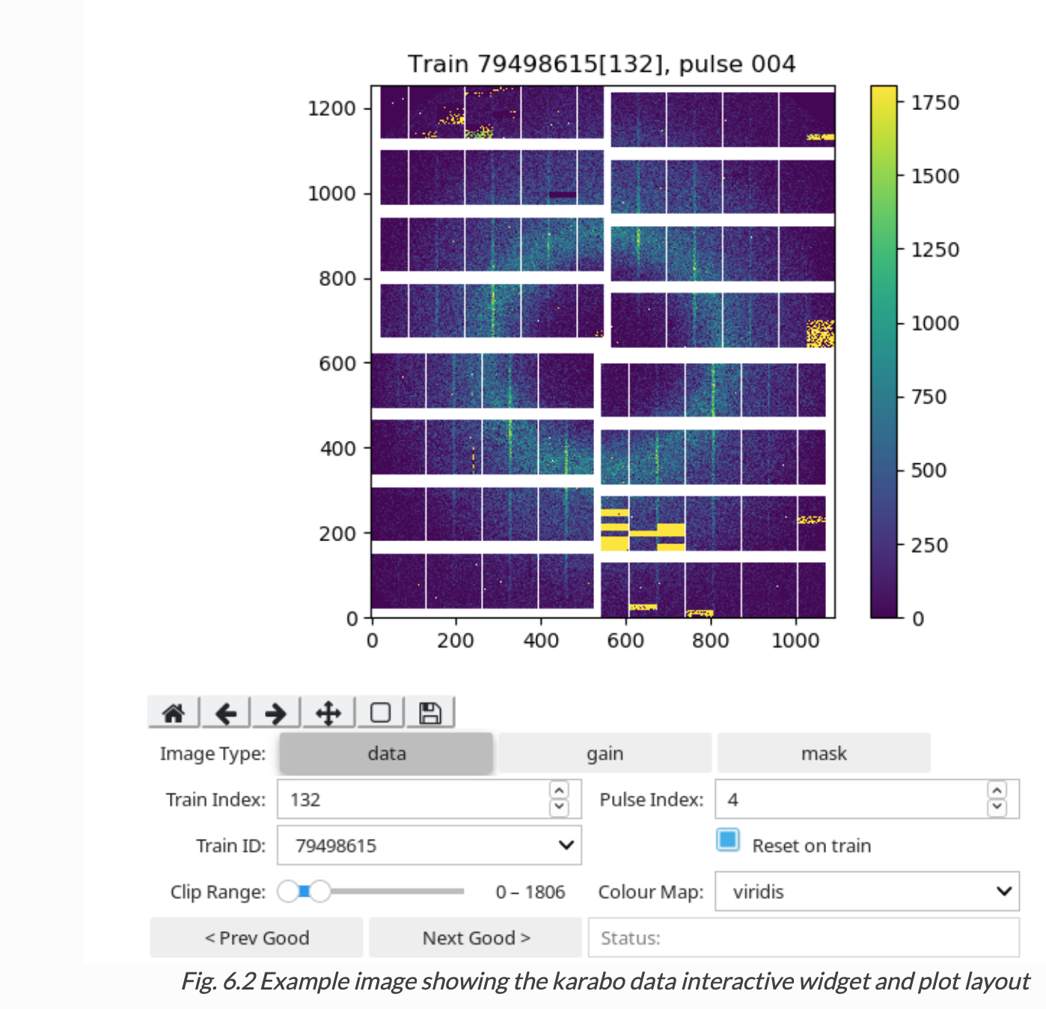
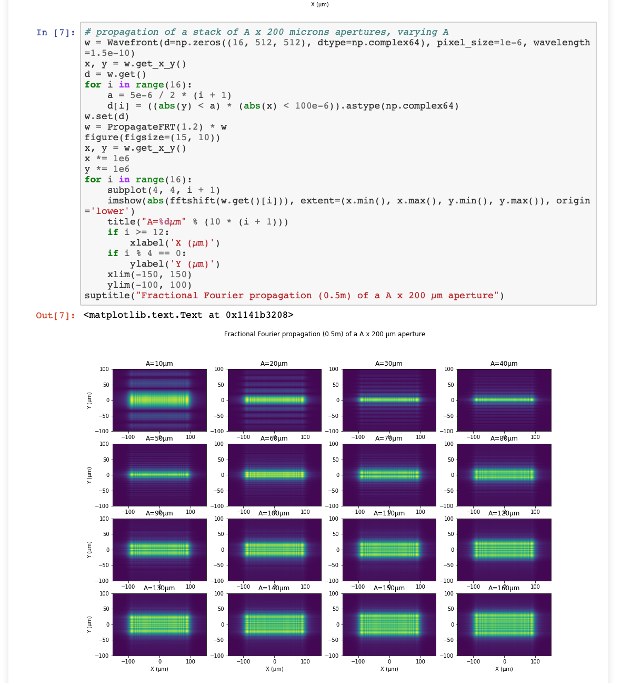
https://in.xfel.eu/readthedocs/docs/data-analysis-user-documentation/en/latest/software.html#karabo-data-interactive
http://ftp.esrf.fr/pub/scisoft/PyNX/example_notebooks/Wavefront-propagation-operators.html

Slide 11
Solution architecture for PaNOSC vision:
Finding data:
Web interface with data base of experiment metadata
Exploring and analysing data remotely (=in the cloud):
JupyterHub serving relevant notebooks
Move data analysis code into the notebook
remote desktop in browser, connected to Desktop of virtual machine

Slide 12
PaNOSC Use case 1: reproducibility and re-usability published results
For a given publication based on facility data, users can
Find the data (through the EOSC web portal or URL/DOI in paper)
Access the data through web portal
Inspect the data analysis (notebook) that led to key figures / statements in the publication
Re-execute the data analysis through (→ reproducibility)
Modify and extend the notebook (→ reusability)
Users may include scientists, interested public, journal editors and reviewers, representatitves from research councils, . . .

Slide 13
PaNOSC Use case 2: enable new data analysis on existing data sets
Users can
Search and find data sets from experiments through web portal
Access the data through web portal
Choose from appropriate selection of data analysis tools (=Jupyter Notebook templates)
Execute the notebook
Modify and extend the notebook

Slide 14
Challenges 1
Different facilities
Currently 6 facilities involved
Generally use different ways to store meta data data
Common way of classifying data sets (and experiment types) ?
Data scale
For some data sets, the data cannot be moved to the compute resource

Slide 15
Challenges 2
Analysis in Notebook
Computational environment – software (containers?)
Need to provide the right computational environment for each analysis type
How can we maintain computational environments in the future (Binder-like?)
Extending up to the life-time of publications and data sets
Which analysis is appropriate for data set → classification of data sets
Making analysis capabilities available in the Jupyter Notebook
Command line drived and Python based computation straightforward,
GUI-based tool more difficult / impossible
What to do with resulting analysis?
Some analysis notebooks require significant HPC resources (execute jobs from notebook?)
Computational environment – hardware, GPUs?

Slide 16
Challenges 3
Concurrent development with EOSC hub
Complicated access rights for data sets
Data policies with embargo period
Publication use case:
Requires collaboration with scientists
Preparation of data analysis notebooks
Social / cultural challenge
Helped by changing metrics and expectations from funding bodies and journals
Research facilities can lead by example

Slide 17
Summary
Introduction PaNOSC project (Photon and Neutron Open Science Cloud), http://panosc-eu.github.io
Focus on data analysis
Use cases
Make publications reproducible
EOSC MyBinder instance as first step?
Allow convenient exploration of existing data sets
Contributions / brain storming / collaboration welcome
This project has received funding from the European Union's Horizon 2020 research and innovation programme under grant agreement No 823852.
Contact presenter:
Hans.Fangohr@xfel.eu, @ProfCompMod,
Contact PaNOSC project:
Andy Götz,
Andy.Gotz@esrf.fr

Slide 18
Acknowledgements
This project has received funding from the European Union's Horizon 2020 research and innovation programme under grant agreement No 823852.

